Slide 1



MiCM workshop: Introduction to PRS and GWAS
Kevin Liang
Brent Richards Group
Quantitative Life Sciences
Lady Davis Institute for Medical Research
Jewish General Hospital

Slide 2
Workshop outline
Introduction of GWAS and PRS
Overview of PRS tools
Plink
P+T
LDpred2
Lasso regression
Calculation of PRS using P+T plink
Evaluate PRS
Overview of existing PRS resources
Limitations/caveats of PRS

Slide 3
Basic terminology
PRS: Polygenic Risk Scores
Same as Polygenic Scores (PGS)
SNP: Single Nucleotide Polymorphisms
Same as variants / alleles
GWAS: Genome-wide association studies
LD: Linkage disequilibrium
MAF: minor allele frequencies

Slide 4

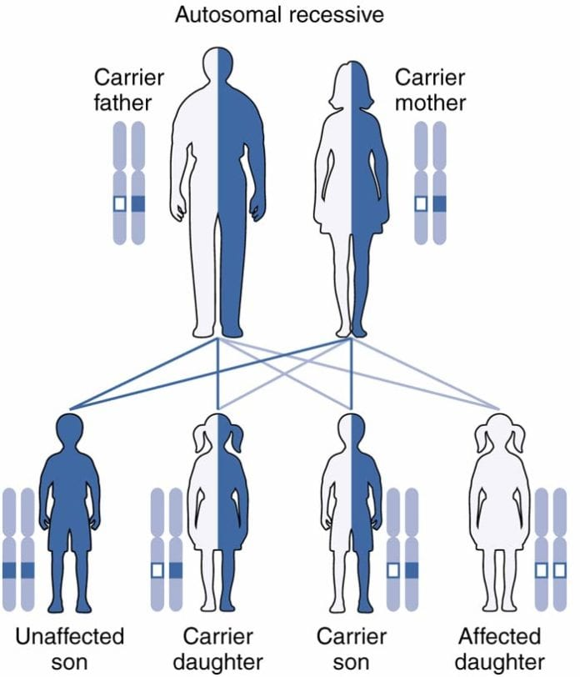
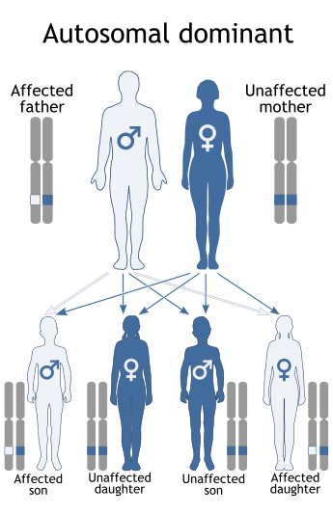
Simple Trait inheritance pattern
Monogenic
(Recessive)
Monogenic
(Dominant)

Slide 5
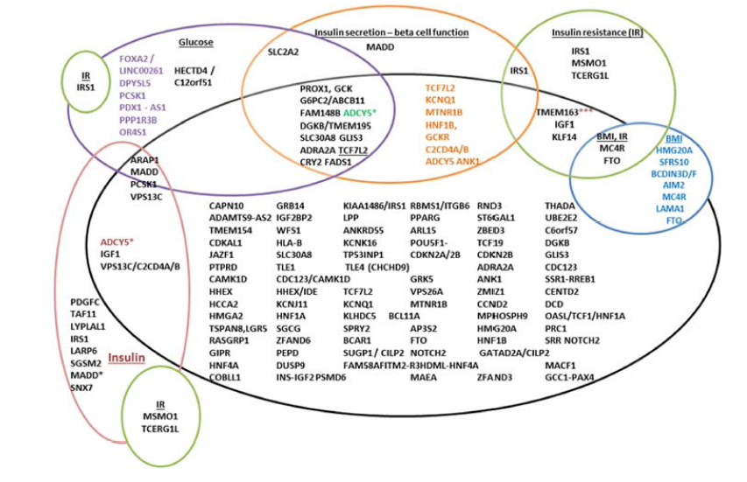
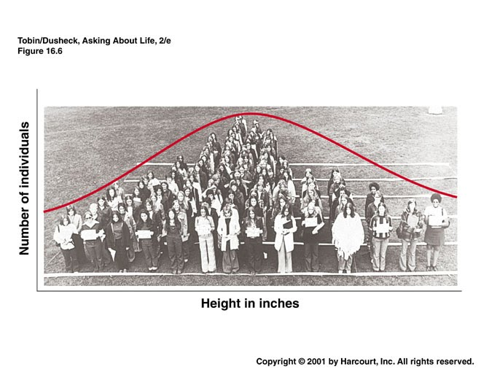
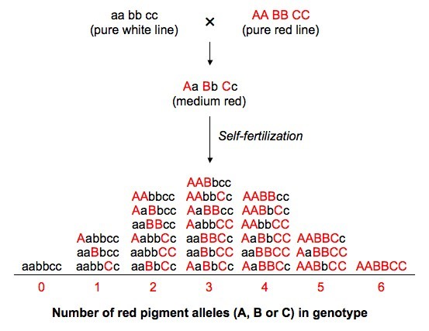
Complex traits
Height
Notes:
how does polygenic trait work -> simple additive model -> PRS

Slide 6
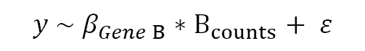
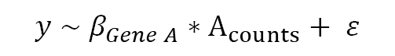
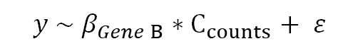
Estimate the effect of SNPs
$$y \sim β_{Gene A}∗A_{counts}+ ε$$
$$y \sim β_{Gene B}∗B_{counts}+ ε$$
$$y \sim β_{Gene B}∗C_{counts}+ ε$$

Slide 7
Estimate the effect of SNPs

Slide 8
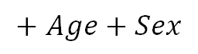
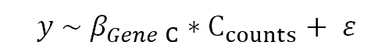
Estimate the effect of SNPs
$$y \sim β_{Gene A}∗A_{counts}+ ε$$
$$+ Age+Sex$$
$$y \sim β_{Gene B}∗B_{counts}+ ε$$
$$+ Age+Sex$$
$$y \sim β_{Gene C}∗C_{counts}+ ε$$
$$+ Age+Sex$$

Slide 9
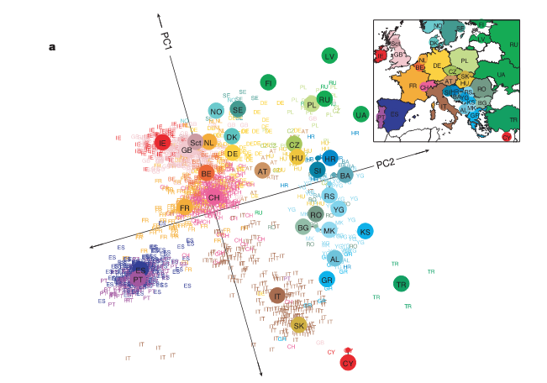
Estimate the effect of SNPs
Population stratification
Novembre, J et al. Genes mirror geography within Europe. Nature
Notes:
leads to population stratification

Slide 10
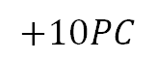
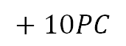
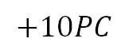
Estimate the effect of SNPs
$$y \sim β_{Gene A}∗A_{counts}+ ε$$
$$+ Age+Sex$$
$$+ 10PC$$
$$y \sim β_{Gene B}∗B_{counts}+ ε$$
$$+ Age+Sex$$
$$+10PC$$
$$y \sim β_{Gene B}∗C_{counts}+ ε$$
$$+ Age+Sex$$
$$+10PC$$
Notes:
Definition of effect/alternate

Slide 11
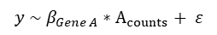
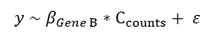

Estimate the effect of SNPs
$$y \sim β_{Gene A}∗A_{counts}+ ε$$
$$y \sim β_{Gene B}∗C_{counts}+ ε$$
$$y \sim β_{Gene B}∗B_{counts}+ ε$$
Notes:
Definition of effect/alternate

Slide 12
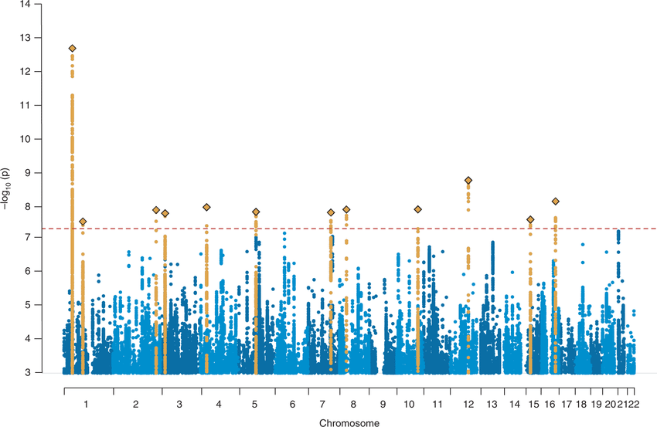
Estimate the effect of SNPs
$$y \sim β_{Gene A}∗A_{counts}+ ε$$
$$y \sim β_{Gene B}∗C_{counts}+ ε$$
$$y \sim β_{Gene B}∗B_{counts}+ ε$$
Notes:
Definition of effect/alternate

Slide 13
Estimate the effect of SNPs
$$y \sim β_{Gene A}∗A_{counts}+ ε$$
$$y \sim β_{Gene B}∗C_{counts}+ ε$$
$$y \sim β_{Gene B}∗B_{counts}+ ε$$
Notes:
Definition of effect/alternate

Slide 14
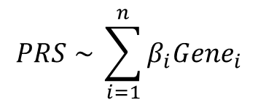
Calculate PRS: Sum them up?
$$PRS \sim \sum_{i=1}^{n}{β_{i}Gene_{i}}$$
Notes:
can we just use the weights

Slide 15
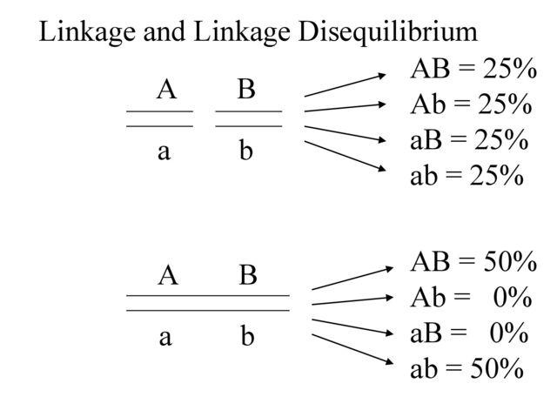
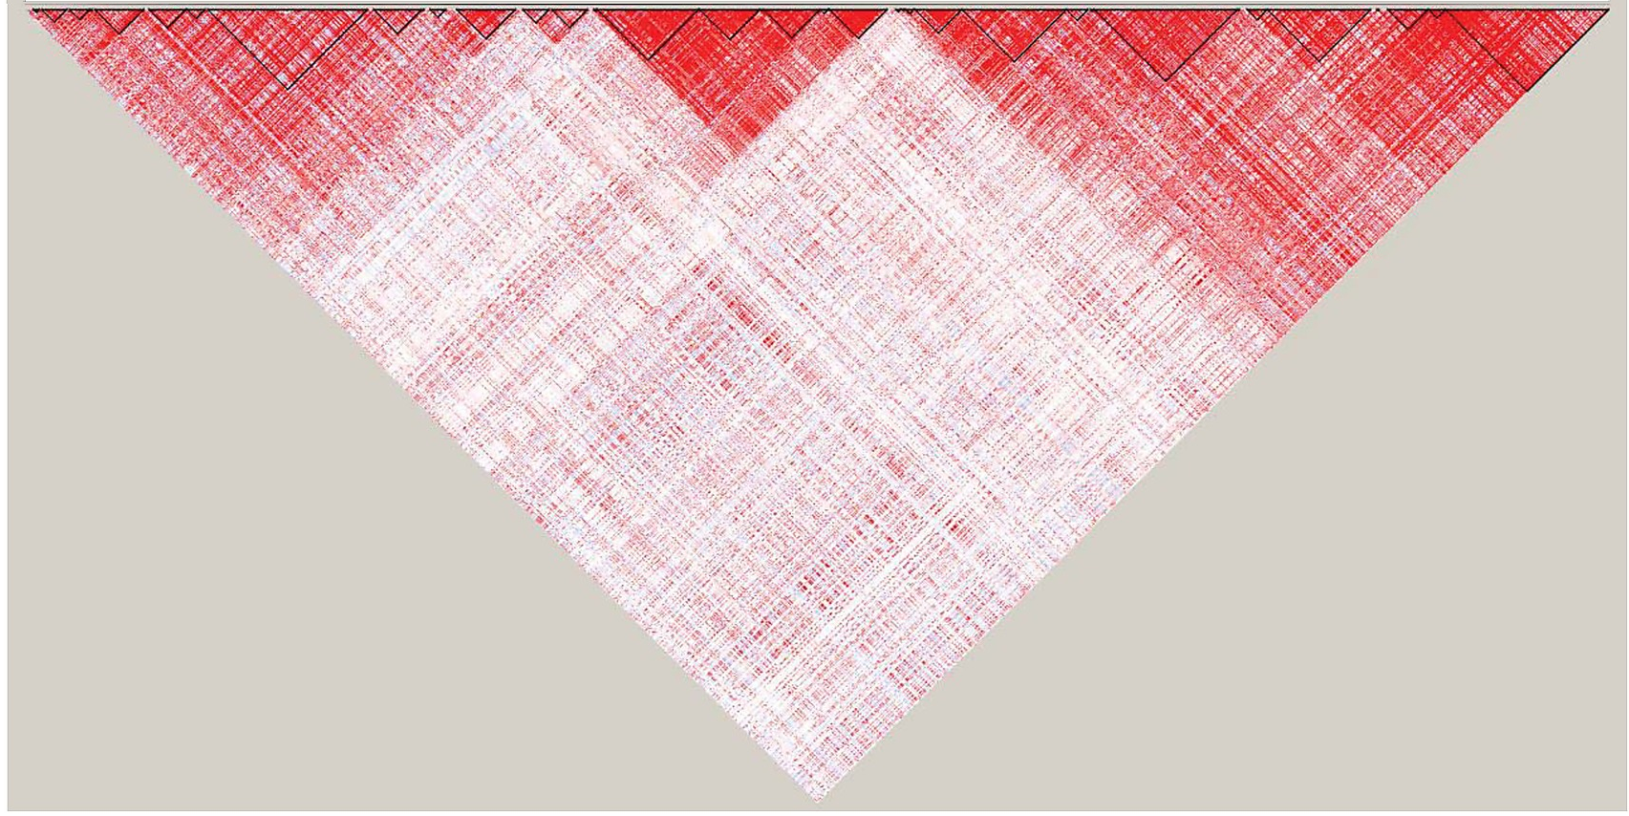
Calculate PRS: Sum them up?
We cannot just sum up the weights as is because of linkage disequilibrium
Must select for (more or less independent) SNPs or account for LD structure

Slide 16
Pruning (Clumping) and thresholding
P+T steps
(Pruning/Clumping) Pick a starting LD threshold
(Thresholding): Filter based on a predefine p-value thresholds
Each of the SNPs that pass this threshold will have some effects and some p-value
SNP1
SNP3
SNP4
SNP5
SNP6
SNP2
SNP1
SNP4
SNP6
Plink2: https://www.cog-genomics.org/plink/2.0/; PRSICE2: Choi et al 2019 GigaScience

Slide 17
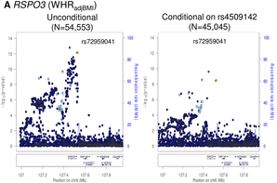
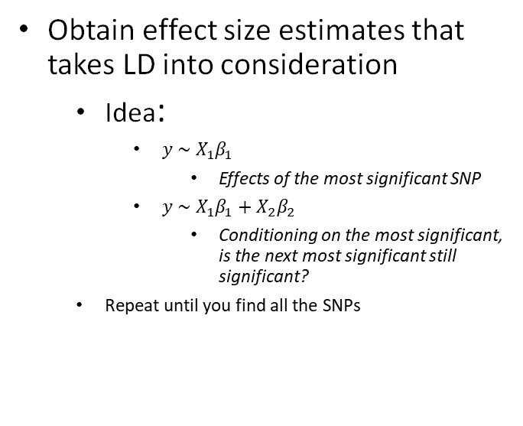
Conditional and Joint analysis (COJO)
Obtain effect size estimates that takes LD into consideration
Idea:
$y \sim X_{1}β_{1}$
Effects of the most significant SNP
$y \sim X_{1}β_{1}+X_{2}β_{2}$
Conditioning on the most significant, is the next most significant still significant?
Repeat until you find all the SNPs
Yang et al .2012. Nature Genetics; Horikoshi et al 2015. PlosGenetics

Slide 18
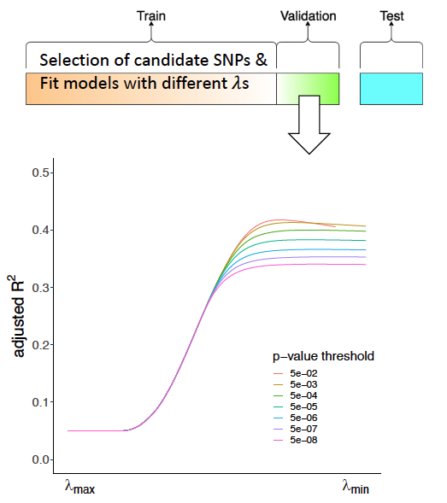
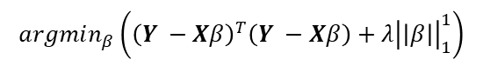
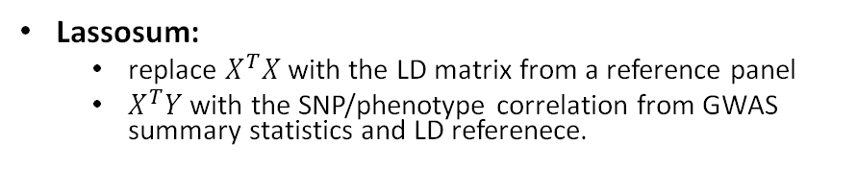
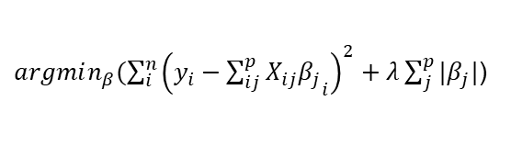
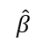
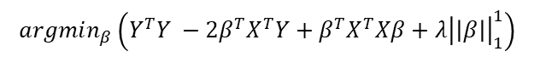
Lasso regression/Lassosum
Lasso regression
$$\hat{β}$$
=
$argmin_{β}(\sum_{i}^{n}{{\left(y_{i}−{\sum_{ij}^{p}{X_{ij}β_{j}}}_{i}\right)}^{2}+λ\sum_{j}^{p}{{|β}_{j}|}}$)
=
$$argmin_{β}\left({\left(Y −Xβ\right)}^{T}\left(Y −Xβ\right)+λ{\left|\left|β\right|\right|}_{1}^{1}\right)$$
=
$$argmin_{β}\left(Y^{T}Y −Y^{T}Xβ − β^{T}X^{T}Y+β^{T}X^{T}Xβ+λ{\left|\left|β\right|\right|}_{1}^{1}\right)$$
=
$$argmin_{β}\left(Y^{T}Y −2β^{T}X^{T}Y+β^{T}X^{T}Xβ+λ{\left|\left|β\right|\right|}_{1}^{1}\right)$$
Lassosum:
replace $X^{T}X$ with the LD matrix from a reference panel
$X^{T}Y$ with the SNP/phenotype correlation from GWAS summary statistics and LD referenece.
Lassosum: Mak et al 2017 Genet Epi

Slide 19
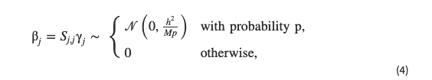
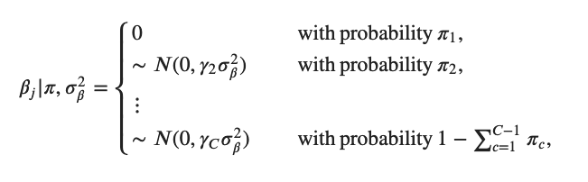
LDPred/SbayesR
LDPred
SBayesR
LDPred: Prive et al 2020. Bioinformatics, SBayesR: Lloyd-Jones et al 2019. Nat Comm.
Notes:
Re organize the slide to have method first then distribution at the end.

Slide 20
Pre-Proccessing PRS Steps overview
Process GWAS results
Checks for ambiguous SNPs
Checks for duplicated SNPs
Checks heritability
Process Genotype data
Remove low quality SNPs (minor allele frequency, Imputation score)
Check GWAS and genotype data match
Make sure the same SNPs have the same alleles
Create Train/Test Split (if applicable)

Slide 21
File type overview
Summary statistics:
.gz file
Genotype data:
Binary plink files:
.bed/.bim/.fam
Large file format
file backed matrices
used by bigsnpr, bigmemory, big.matrix

Slide 22
Practical datasets: effect size distribution

Slide 23
Practical datasets: Manhattan plots
Notes:
fix the green dots

Slide 24
Practical: Obtain PRS weights using P+T and biglasso
obtain covariates
6 Principle components using Plink2
Sex information from Fam file
1 = male, 2 = female
Run Prsice2 with default settings except
printing out variants
obtain the input file of selected SNPs for plink2
Run biglasso using the prsice2 SNPs (usually you could try different C+T thresholds)
Obtain input file of selected SNPs for plink

Slide 25
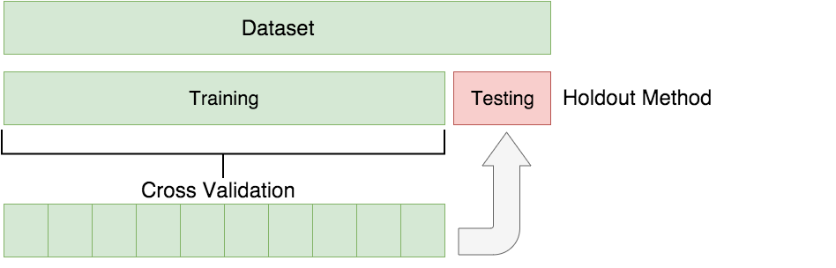
Evaluation of PRS performance
Evaluation of PRS should be done in a hold-out set that the model has not seen before.
All the metrics that we will discuss will be results from the testing set
This is to avoid overfitting

Slide 26
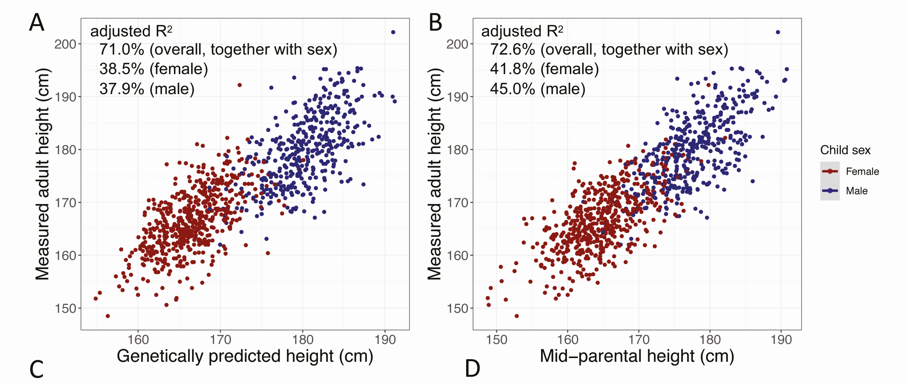
Evaluation of PRS performance
Comparing correlation
Lu et al 2021 JCEM

Slide 27
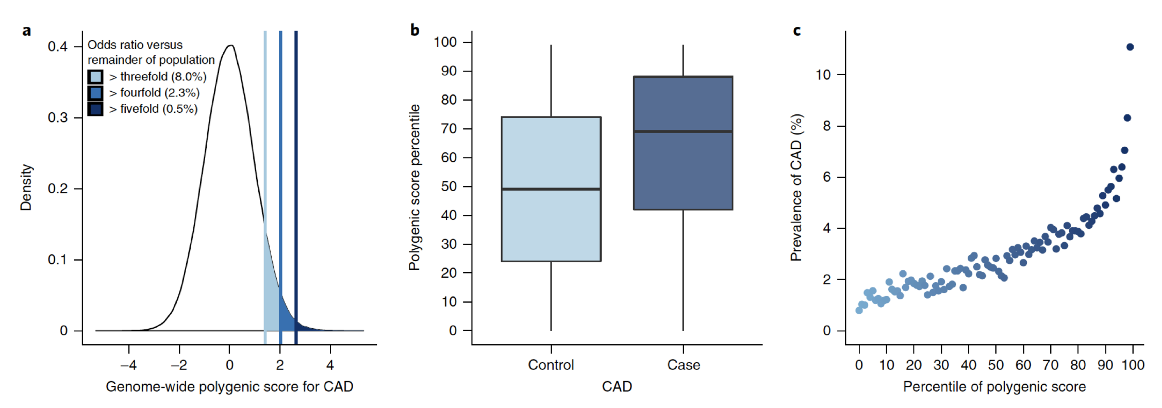
Evaluation of PRS performance
Risk stratification/OR
Khera, Nat Genet

Slide 28
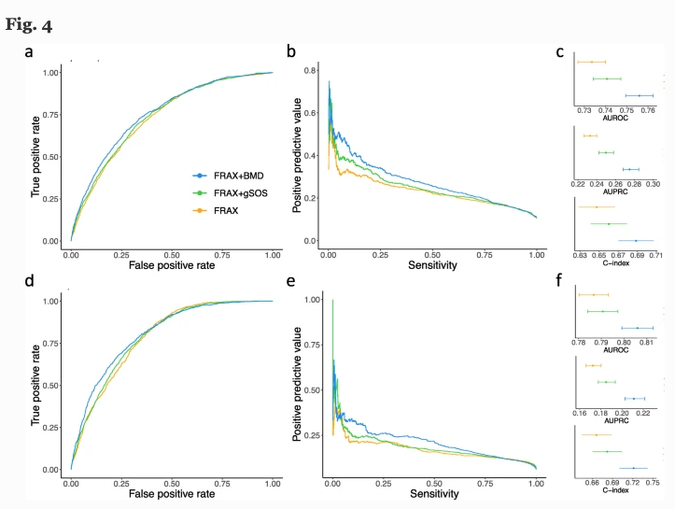
Evaluation of PRS performance
Receiver operator curve/ Precision Recall curve
Lu et al 2021 JCEM

Slide 29
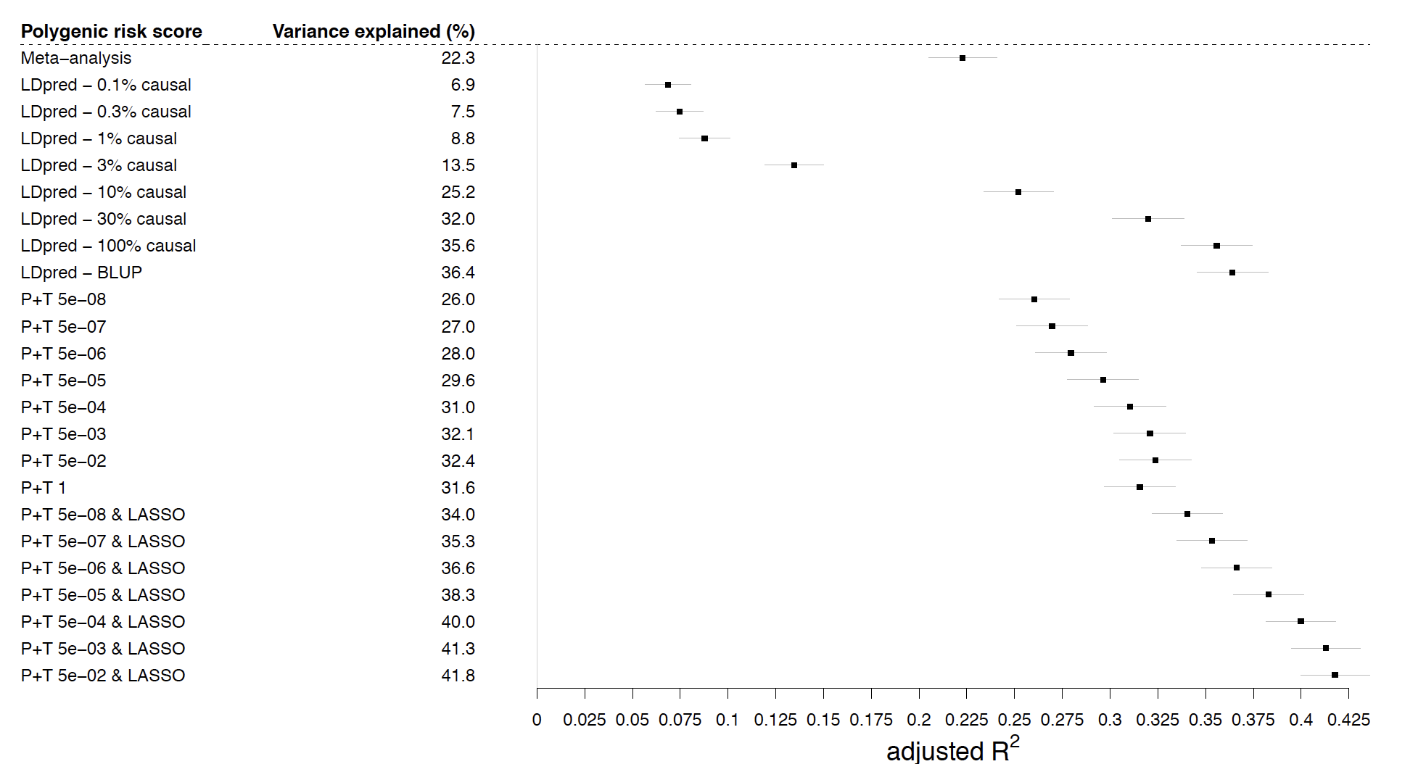
Which methods?
Lu et al 2021 JCEM

Slide 30
Practical: Evaluate Our PRS
Calculate Lasso and Prsice2 PRS in test data
Obtain performance comparing the 2 scores

Slide 34
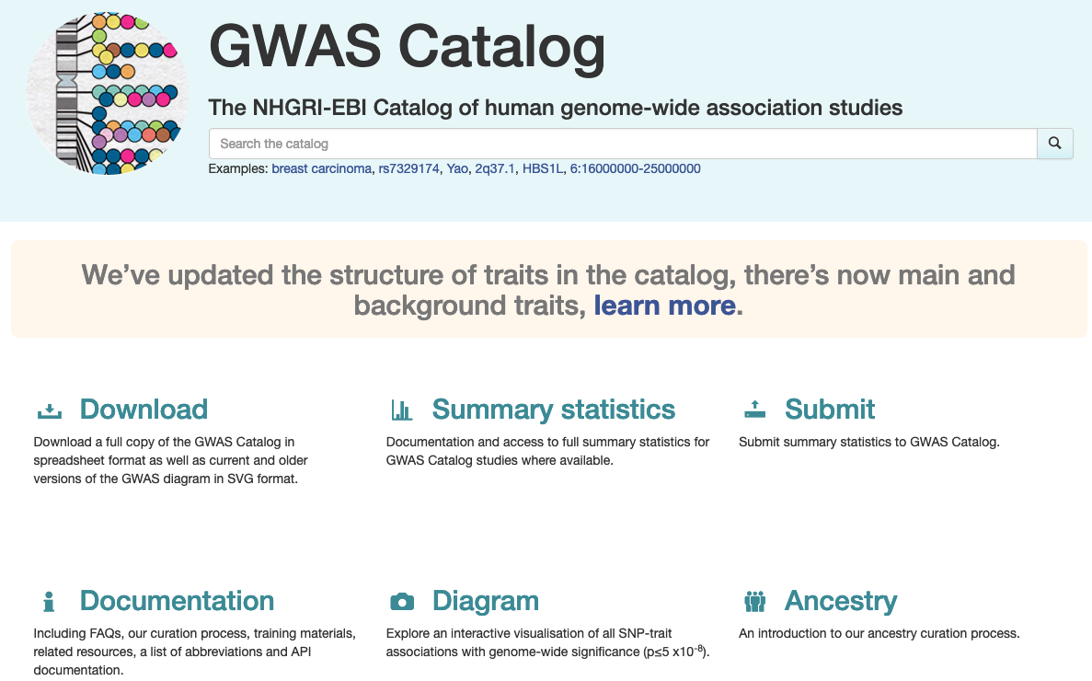
PRS/GWAS resources
https://www.ebi.ac.uk/gwas/
Notes:
Demo

Slide 35
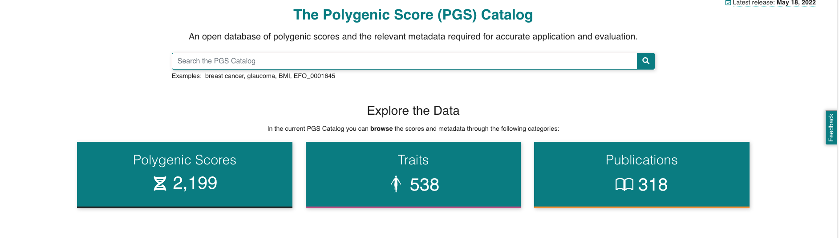
PRS resources: PGS catalog
https://www.pgscatalog.org/
Notes:
Demo

Slide 36
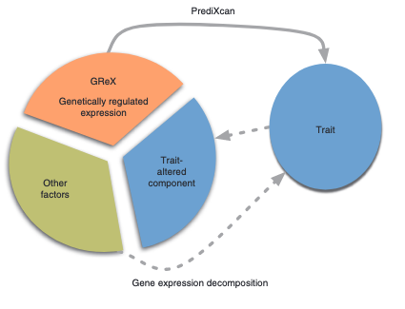
Other resources: GTEx
Gamazon et al 2015 Nat Genet, https://predictdb.org/

Slide 37
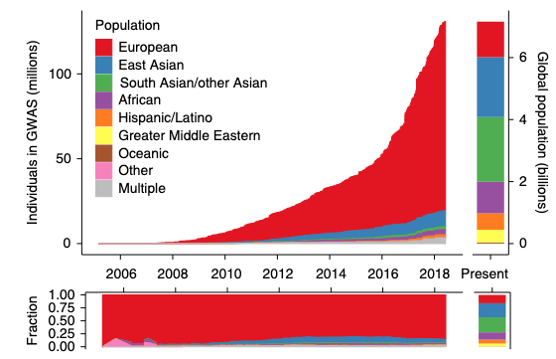
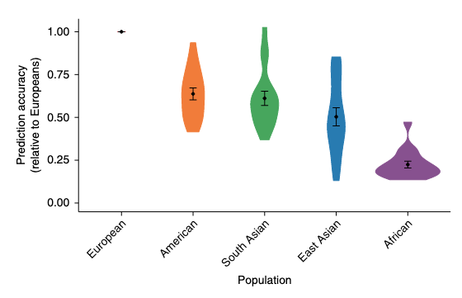
Limitation/caveats
PRS like GWAS are also population specific
Martin et al 2019. Nat Genet

Slide 38
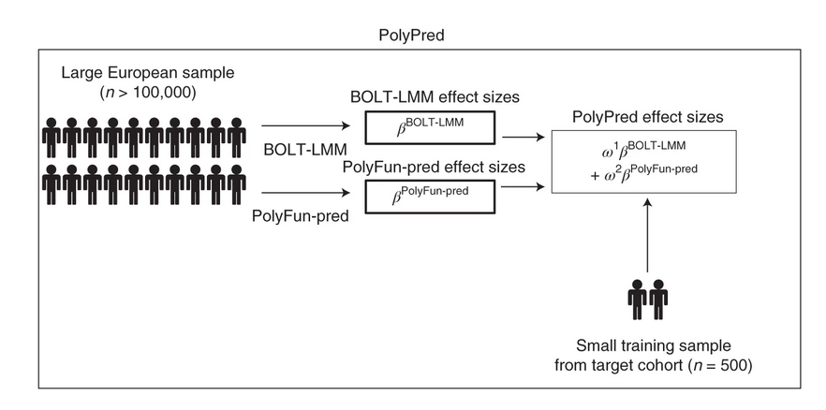
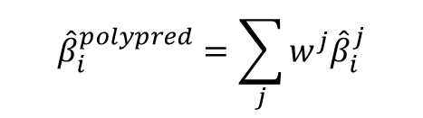
PolyPred: trans-ethnic predictions
$${\hat{β}}_{i}^{polypred}=\sum_{j}{w^{j}{\hat{β}}_{i}^{j}}$$
for the j^{th} predictors of SNP i
European population: Large datasets provides accurate estimation of SNP effect sizes.
Non-European: small datasets, but can capture non-European population specific effect sizes (high variance)
PolyPred: Combines information from both sources
Notes:
which paper pred

Slide 39

Limitation/caveats
PRS like GWAS are also population specific

